Slide 1
Software Alternatives Analysis Using AlternativeTo Data
Turning 3,000+ software records into a single source of truth — through an end-to-end data analytics pipeline powered by Python, SQL Server, and interactive dashboards.
P R O J E C T T E A M
• Rahma Ahmed • Faten Ahmed • Rahma Mohamed
Team Leader : Faten Ahmed
Project Supervisor : Eng. Abdullah Ashraf

Slide 2





Agenda
W H A T W E ' L L C O V E R
01
02
02
03
Project Overview
Key Metrics & Results
Technical Architecture
04
05
Interactive Dashboards
Recommendations
02

Slide 3
Project Idea
C H A P T E R 1 · P R O J E C T O V E R V I E W
The project focuses on analyzing software alternatives using data from the AlternativeTo website, which provides comprehensive information about software applications, their alternatives, ratings, licensing models, and supported platforms. We collected and analyzed data for over 3,000 software applications to better understand the software ecosystem and support data-driven software comparison.
Business Problem
The software market is growing rapidly, but many developers make decisions based on trends instead of real market analysis. As a result, they may build applications in highly competitive categories without understanding the market. For example, over the past few years, many developers focused on AI chatbot applications because of their popularity, even though the market had already become highly competitive.
03

Slide 4
Objectives
C H A P T E R 1 · P R O J E C T O V E R V I E W
The main objective of our project is to understand the factors that influence software development and licensing decisions. We analyzed whether the licensing model affects the pricing model, whether the supported platform influences pricing, which operating systems are most commonly targeted by developers, and whether operating systems are related to pricing strategies. We also performed geographical analysis to explore software distribution across different countries.
Target Audience
Our target audience includes software developers, product owners, and businesses. They can use these insights to make better decisions when developing new software, selecting pricing and licensing models, identifying market opportunities, or choosing software alternatives based on their needs.
04

Slide 5





The Dataset Behind the Story
C H A P T E R 1 · D A T A F O U N D A T I O N
3,000+
Software Applications
16
Software Attributes
6
Continents Covered
NA · EU · AS · AF · OC · SA
3
Technologies Used
· Python · SQL
· Streamlit
Key Attributes Analyzed
License Type Pricing Model
Country Continent
Platform
App Type
Operating System
Technology Stack: Data Collection (Playwright, Requests) → Data Processing (Pandas) → Data Storage (SQL Server) → Interactive Dashboard (Streamlit).
05

Slide 6








Eight SMART Questions Guiding the Analysis
C H A P T E R 2 · R E S E A R C H F R A M E W O R K
01
Pricing Analysis
Does License Category affect Pricing Category?
02
Platform Analysis
Does Platform affect Pricing Category?
03
Geographic Insights
What are the Top 3 App Types developed in each continent?
04
Operating System Comparison
Operating System Comparison
05
Platform Distribution
Supported Platforms Across Continents
06
Language Distribution
Distribution of Supported Languages Across Applications
07
License analysis
Number of apps by License_category
08
Decision Support
How can data-driven insights guide pricing, platform selection, and market target decisions?
06

Slide 7


Business Insights & KPIs
C H A P T E R 2 · Key Metrics & Results
Application Categories
The analysis shows that AI Chatbots are the most common application category, with 127 applications, followed by Note-Taking applications (89) and To-Do List Managers (72). This indicates that AI Chatbots represent a highly competitive segment of the market. Developers planning to build AI chatbot applications should consider offering unique features or a clear value proposition to stand out. In contrast, less crowded categories, such as AI Writing Tools (70 applications), may provide opportunities for entering the market with lower competitive pressure.
Pricing & Licensing
The analysis shows that Free and Freemium are the dominant pricing models, while Paid applications represent only a small portion of the market. This suggests that free and low-cost pricing strategies are the most widely adopted in the software industry. In addition, Free applications are predominantly associated with Open Source licenses, whereas paid models are more commonly linked to Proprietary licenses, indicating a clear relationship between licensing models and pricing strategies.
11/07/2026
07

Slide 8


Business Insights & KPIs
C H A P T E R 2 · Key Metrics & Results
Geographic Distribution
The analysis shows that software development is primarily concentrated in North America and Europe. At the country level, the United States leads with 876 applications, followed by the United Kingdom and Germany. In terms of application categories, AI applications dominate in North America and Asia, while Productivity applications are the most prevalent in Europe and South America. These findings suggest that developers should consider regional market preferences when selecting their target market, as software demand and application trends vary across geographic regions.
Platforms
The analysis reveals that Web is the most widely supported platform, followed by Desktop and Mobile. Among desktop operating systems, macOS has the highest number of supported applications, followed by Windows and Linux. Furthermore, Free and Freemium pricing models are the most common on both macOS and Linux, suggesting that platform choice is closely associated with software pricing strategies.
11/07/2026
08

Slide 9
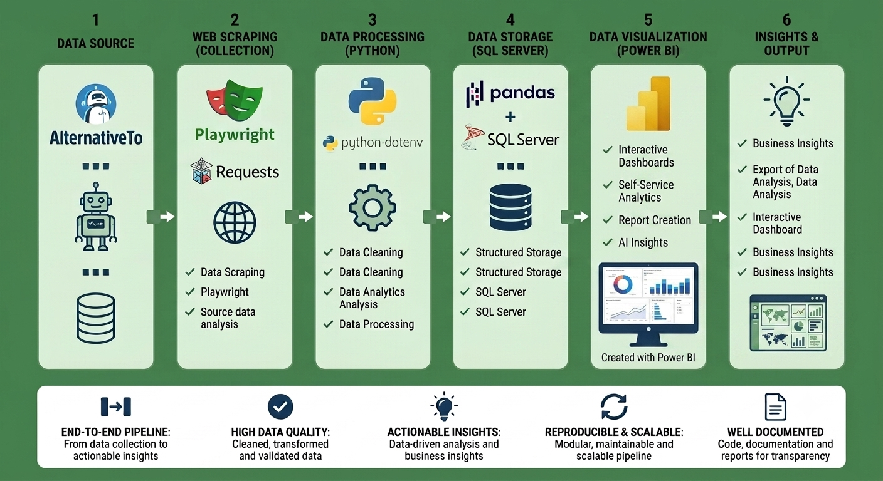
Enterprise Data Pipeline & Architecture
C H A P T E R 3 · D A T A P I P E L I N E
09

Slide 10
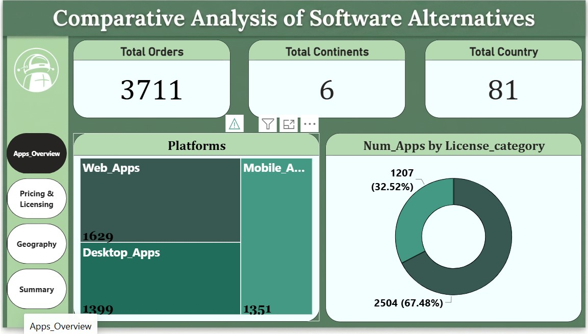
D A S H B O A R D 1 O F 4 · P O W E R B I C O M M A N D C E N T E R
10

Slide 11
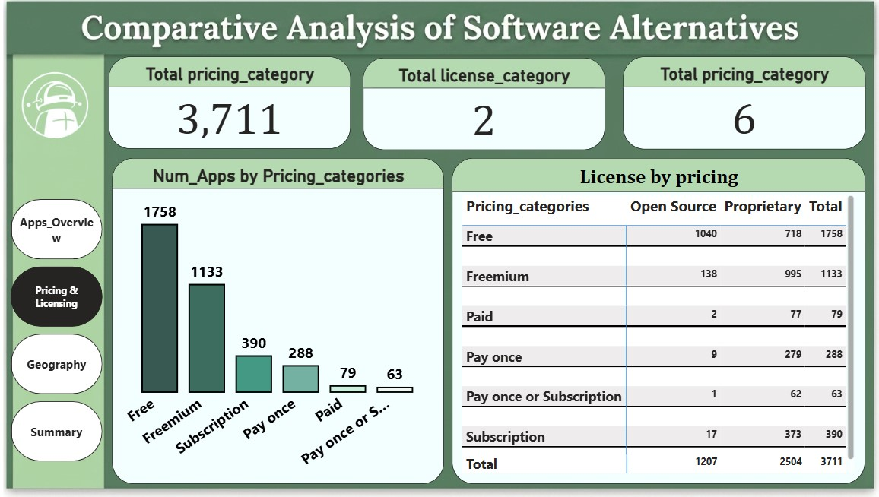
D A S H B O A R D 2 O F 4 · P O W E R B I C O M M A N D C E N T E R
11

Slide 12
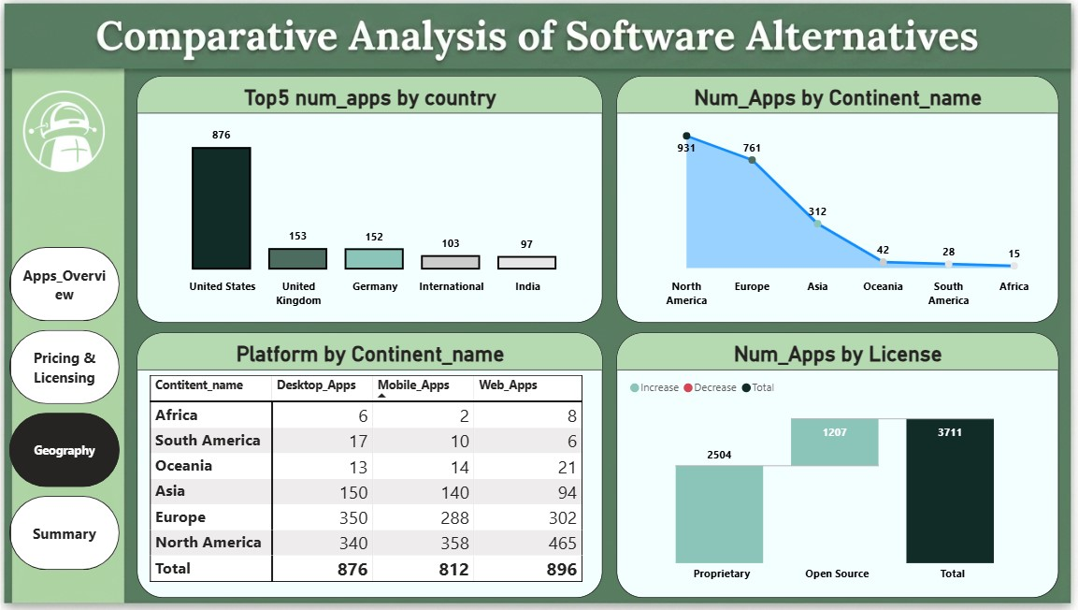
D A S H B O A R D 3 O F 4 · P O W E R B I C O M M A N D C E N T E R
12

Slide 13
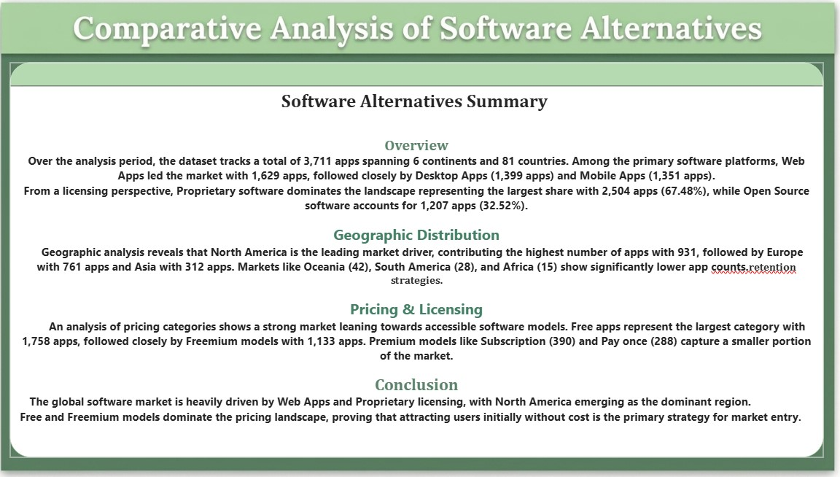
D A S H B O A R D 4 O F 4 · P O W E R B I C O M M A N D C E N T E R
13

Slide 14
Recommendations
C H A P T E R 5 · Recommendations
1
Evaluate market competition before selecting an application category; highly competitive categories require clear differentiation.
Align the pricing model with the target platform (Web/Mobile → Free or Freemium, Desktop → Pay Once).
Choose the licensing model based on business goals (Open Source for wider adoption, Proprietary for direct revenue).
Support multiple languages to increase market reach and gain a competitive advantage.
Consider regional market differences when targeting users, as application preferences vary across geographic regions
2
3
4
5
14

Slide 15

Thank You
Questions & Discussion
• Rahma Ahmed • Faten Ahmed
• Rahma Mohamed

